Slide 1

IT Tickets Handling Process Improvement
Lean Six Sigma Project
Chippy Pillai
School of Technology and Innovations
Major in Strategic Project Management
Master's programme in Industrial Engineering and Management
Vaasa 2026

Slide 2

Project Summary
This project analyzed IT helpdesk ticket handling to identify and resolve inefficiencies. Using the DMAIC methodology, we examined 2,347 tickets over six months, focusing on reducing resolution times and improving consistency.
Key Findings
32% of resolution time was consumed by redundant information gathering, and 22% of tickets were misrouted.
Achieved Improvements
Average Resolution time reduced by 48%, delayed high/medium priority tickets reduced by 52%, and customer satisfaction increased by 32%.

Slide 3


Introduction & Problem Statement
Problem
Goals
Inconsistent IT helpdesk ticket resolution, with many tickets exceeding 24 hours, leads to customer dissatisfaction and inefficiency.
Reduce average resolution time to ≤ 5 hours.
Increase first call resolution rate from 55% to ≥ 80%.
Improve customer satisfaction from 68% to 85%.
Decrease escalation rate from 28% to 15%.

Slide 4


Project Scope
In Scope
Out of Scope
Ticket Submission and Categorization
Major Infrastructure Upgrades
Initial Triage and Assignment Workflow
Security Incident Handling
Resolution and Closure Procedure
Procurement Process

Slide 5


Voice of Customer (VOC)
Understanding customer needs is crucial for improving the IT helpdesk process.
Survey Responses
Focus Groups
Complaint Analysis
356 responses identified "slow resolution" as the primary pain point.
4 sessions with 28 internal customers provided qualitative feedback.
127 complaints recorded in the past year highlighted recurring issues.

Slide 6
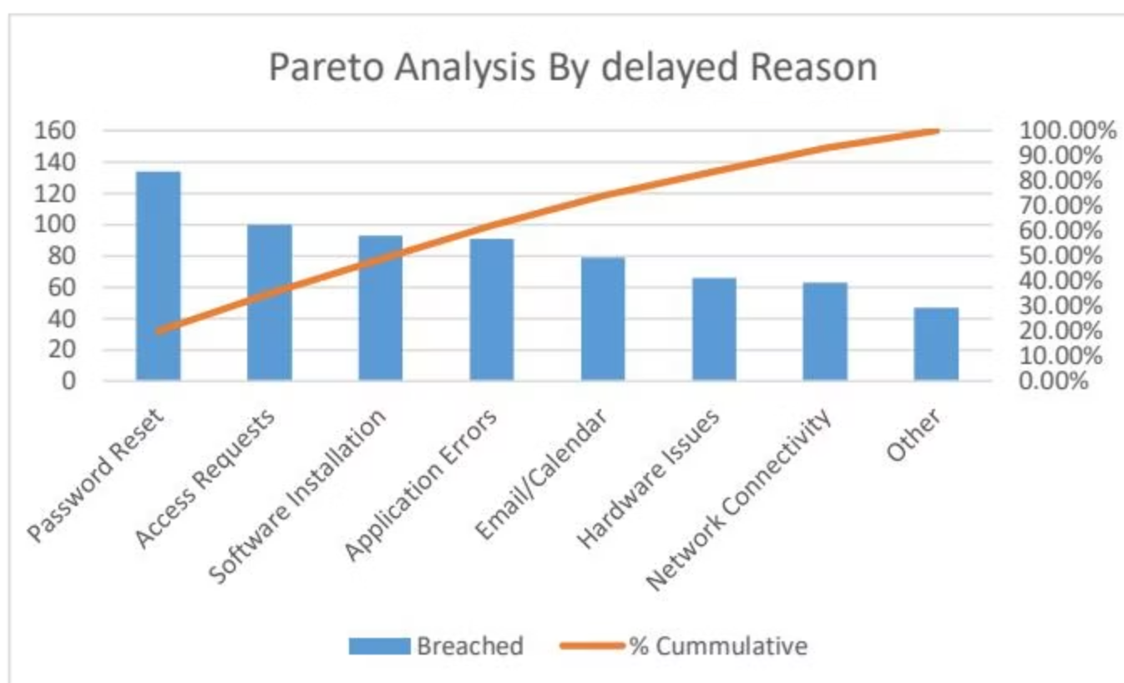
Baseline Performance & Pareto Analysis
Baseline Data
Reasons for Delay
Total Tickets
2,347
Avg Resolution Time
9.75 days
SLA Compliance
71.32%
SLA Violations
28.68%
Average resolution time is 9.75 days, with nearly 29% of tickets experiencing delays.
Password Reset, Access Requests, Software Installation, and Application Errors account for 60% of all delays.

Slide 7
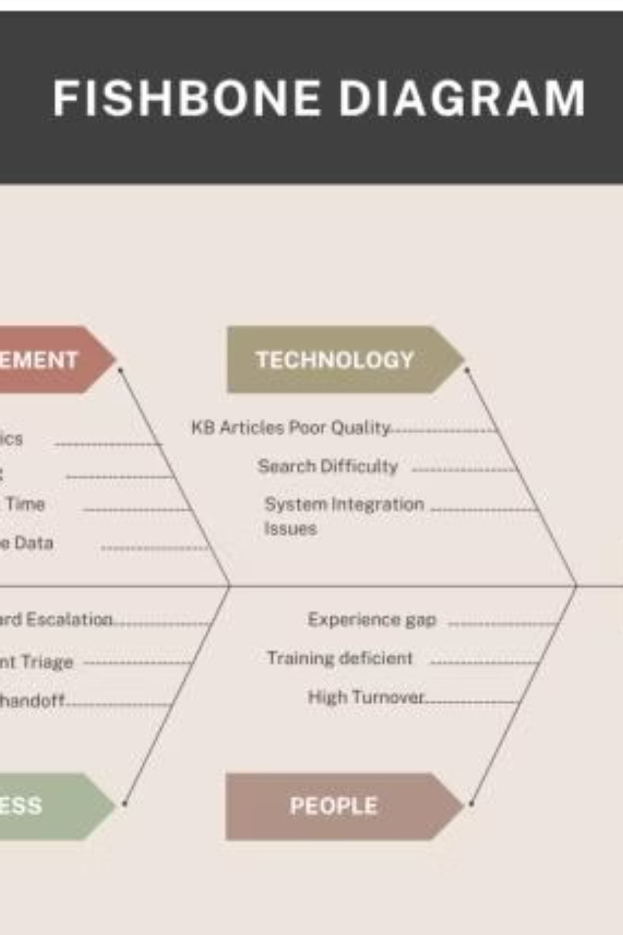
Root Cause Analysis
People
Insufficient Training
Experience Gap
High Turnover
Process
No Standardized Escalation
Inefficient Triage
Multiple Handoffs
Technology
Poor KB Quality
Search Difficulty
System Integration Issues
Measurement
Delayed SLA Metrics
Incomplete Data
No FCR Tracking

Slide 8





Improvement Solutions
Enhanced Knowledge Base
Implement article rating, feedback loops, and template-based structures.
Tiered Escalation Matrix
Define clear criteria and introduce pre-escalation peer reviews.
Technician Training
Monthly workshops on breach categories and mentorship programs.
Ticket Intake Improvement
Mandatory fields and guided submission forms for complete initial info.

Slide 9
Pilot Results & Control Plan
Pilot Results
Control Plan
Metric
Before
After
Improvement
Metric
Control Method
Owner
SLA %
Weekly dashboard
IT Manager
Avg Resolution Time
18.4 hrs
14.5 hrs
↓ 21%
Resolution Time
Monthly review
Team Lead
SLA Compliance
62 %
78 %
↑ 16%
Reassignments
Audit reports
QA Team
Standardized procedures, integrated escalation matrix, and continuous training ensure sustainability.
Reassignments
28 %
18 %
↓ 36%
The pilot demonstrated significant improvements in resolution time, SLA compliance, and reduced reassignments.

Slide 10

Benefits & Conclusions
Benefits Earned
Reduced SLA penalties, increased productivity, improved customer satisfaction, and enhanced team morale.
Lessons Learned
Strong executive sponsorship and technician involvement were key. Early stakeholder engagement and robust testing are areas for improvement.
The Lean Six Sigma DMAIC project successfully transformed the IT Helpdesk, eliminating waste and standardizing workflows. This project serves as a model for future process improvements.

